Slide 1
Design and Analysis of Algorithms
UNIT-1
Introduction

Slide 2
Topics
Algorithm Specification
Pseudocode Convention
Types of Algorithms
Performance Analysis
Asymptotic Notations

Slide 3
What is an Algorithm
•
An algorithm is a set of rules.
•
An
algorithm
is
a
step-by-step procedure
An algorithm is a sequence of computational steps
•
•
An algorithm is a sequence of operations performed
data.
on
•
An
algorithm is an
abstraction
of
a
program
Algorithm refers to a method that can be used by a computer for the solution of a problem
Computation).

Slide 4
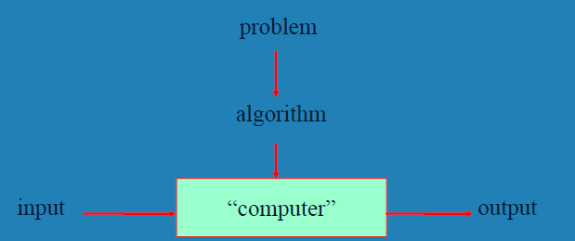
What is an Algorithm
Definition
An Algorithm is a finite set of instructions that, if followed, accomplishes a particular task.

Slide 5
Characteristics of an Algorithm
All algorithms must satisfy the following criteria:
(1)Input. There are zero or more quantities that are externally supplied.
(2)Output. At least one quantity is produced.
(3)Definiteness. Each instruction is clear and unambiguous.
(4)Finiteness. If we trace out the instructions of an algorithm, then for all cases, the algorithm terminates after a finite number of steps.
(5)Effectiveness. Every instruction must be basic enough to be carried out, in principle, by a person using only pencil and paper. It is not enough that each operation be definite and also must be feasible.

Slide 6
Study of Algorithms
The study of algorithms includes many important and active areas of research.
Four distinct areas of study:
1. How to devise algorithm
2. How to validate algorithm
3. How to analyze algorithms
4. How to test a program

Slide 7
Devise and Validate an Algorithm
Devise an Algorithm:
Study various design techniques that have proven to be useful in that they have often yielded good algorithms.
Various design Strategies:
Divide and Conquer
Greedy Method
Dynamic Programming
Back Tracking
Branch & Bound
Validate an Algorithm:
Once an algorithm is devised, it is necessary to show that it computes the correct answer for all possible legal inputs.
Once the validity of the method has been shown, a program can be written and a second phase begins.

Slide 8
Analyze and Test the Algorithms
3. Analyze the Algorithm
Analysis of algorithms or performance analysis refers to the task of determining how much computing time and storage an algorithm requires.
4. Test a Program
Testing a program consists of two phases: debugging and profiling (or performance measurement).
Debugging is the process of executing programs on sample data sets to determine whether faulty results occur and, if so, to correct them.
A proof of correctness is much more valuable than a thousand tests(if that proof is correct),since it guarantees that the program will work correctly for all possible inputs.
Profiling or performance measurement is the process of executing a correct program on datasets and measuring the time and space it takes to compute the result.

Slide 9
Topics
Algorithm Specification
Pseudocode Convention
Types of Algorithms
Performance Analysis
Asymptotic Notations

Slide 10
Describing Algorithms
Natural language
English
Instructions must be definite and effectiveness
Graphic representation
Flowchart
work well only if the algorithm is small and simple
Pseudocode
Readable
Instructions must be definite and effectiveness

Slide 11
Pseudocode
Pseudocode:
Implementation of an algorithm in the form of annotations and informative text written in plain English.
It has no syntax like any of the programming language and thus can’t be compiled or interpreted by the computer.
Advantages of Pseudocode
Improves the readability of any approach.
Acts as a bridge between the program and the process. Also works as a rough documentation, so the logic of one developer can be understood easily when a pseudo code is written out.
Explains what exactly each line of a program should do, hence making the code construction phase easier for the programmer.
Disadvantages of Pseudocode
Pseudocode does not provide a visual representation of the logic of programming.
There are no proper format for writing the for pseudocode.

Slide 12
Pseudocode Conventions
1. Comments begin with // and continue until the end of line.
2. Block of statements are indicated with matching braces:{ and }.
3. Statements are delimited by “;”.
4. The data types of variables are not explicitly declared. Compound data types can be formed with records.
node = record
{
data type_1 data;
.
.
.
data type_n data;
node *link;
}

Slide 13
Pseudocode Conventions
5. Assignment of values to variables is done using the assignment statement variable:=expression or value;
6. There are two Boolean values true and false. In order to produce these values, the logical operators and, or, and not and the relational operators <, and > are provided.
7. Elements of multi dimensional arrays are accessed using ‘[‘ and ‘]’.
For example, if A is a two dimensional array, the (i,j)th element of the array is denoted as -A[i,j].
8. The while, repeat-until and for loops takes the following form:
while (condition)do
{
statement 1 …
statement n
}
Repeat
{
Statement 1 …. Statement n
} until(condition)
for variable:= value l to value 2 step value do
{
(statement 1) ….
(statement n)
}

Slide 14
Pseudocode Conventions
9. A conditional statement has the following forms:
if (condition) then statement;
if (condition) then statement 1 else statement 2;
case
{
: condition 1: statement 1 …..
: condition n: statement n
: else: statement n + 1
}
10. Input and output are done using the instructions read and write.
11. There is only one type of procedure: Algorithm.
An algorithm consists of a heading and a body.
The heading takes the form Algorithm Name(parameter list)

Slide 15
Tasks on Algorithms
Write an algorithm to merge the given two sorted arrays as one sorted array.
Write an algorithm for printing nth Fibonacci number.
Write an algorithm to find the maximum product of two integers in the given array.

Slide 16
Topics
Algorithm Specification
Pseudocode Convention
Types of Algorithms
Performance Analysis
Asymptotic Notations

Slide 17
Types of Algorithms
Two Types of Algorithms:
Iterative Algorithms
The iteration is when a loop repeatedly executes until the controlling condition becomes false.
Recursive Algorithms
An algorithm is said to be recursive if the same algorithm is invoked in the body.
An algorithm that calls itself is direct recursive.
Algorithm A is said to be indirect recursive if it calls another algorithm which in turn calls A.
The primary difference between recursion and iteration is that recursion is a process, always applied as a function and iteration is applied to the set of instructions which we want to get repeatedly executed.

Slide 18
Example for Recursive Algorithms
Towers of Hanoi Problem

Slide 19
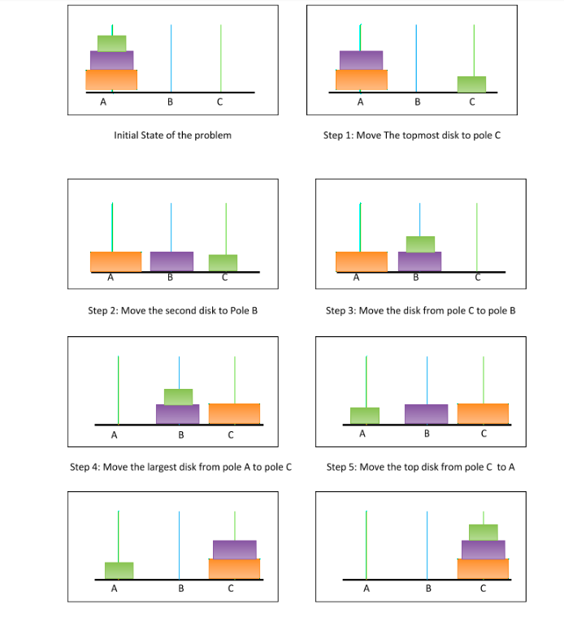
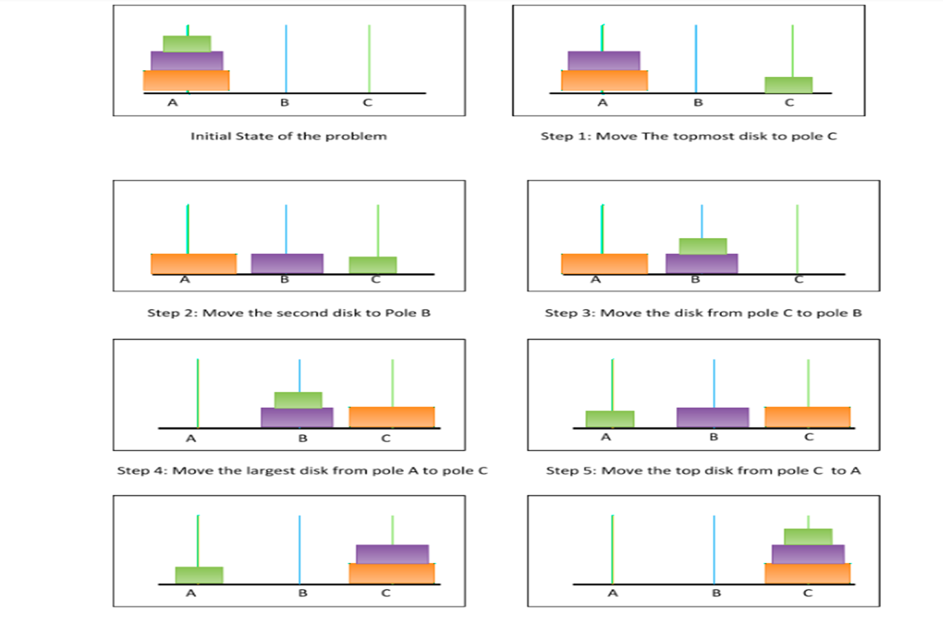
Example for Recursive Algorithms

Slide 20
Example for Recursive Algorithms

Slide 21
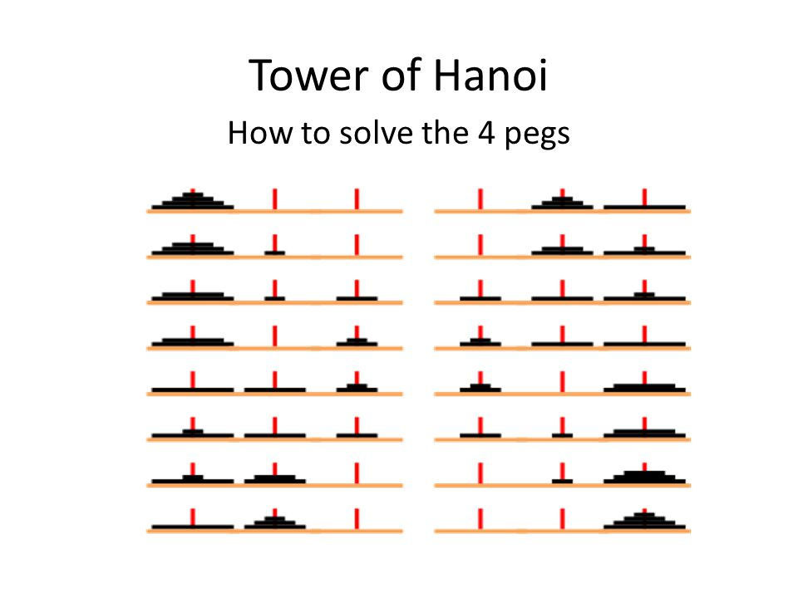
Example for Recursive Algorithms

Slide 22
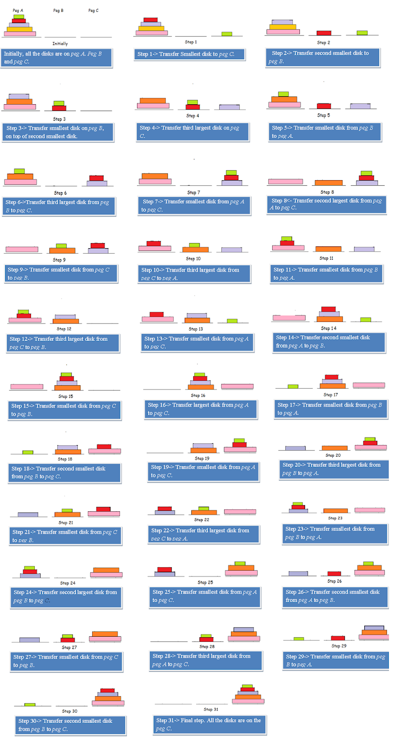

Slide 23
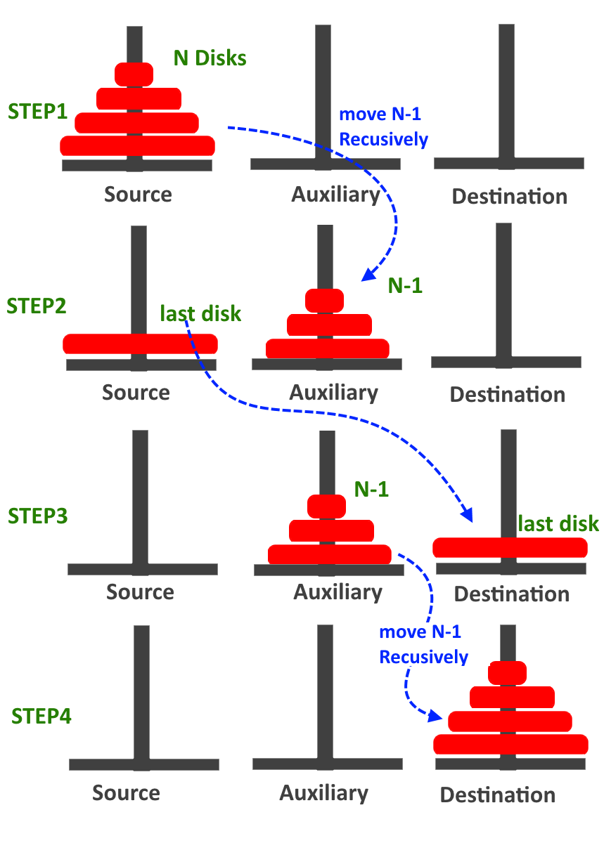
Example for Recursive Algorithms

Slide 24
Example for Recursive Algorithms
Algorithm Hanoi(disk, source, dest, aux)
{
IF (disk == 1), THEN
move disk from source to dest;
ELSE
{
Hanoi(disk - 1, source, aux, dest); // Step 1
Write ‘move disk n from source to dest’; // Step 2
Hanoi(disk - 1, aux, dest, source); // Step 3
}
}

Slide 25
Topics
Algorithm Specification
Pseudocode Convention
Types of Algorithms
Performance Analysis
Asymptotic Notations

Slide 26
Performance Evaluation
Evaluate a program
MWGWRERE
Meet specifications, Work correctly,
Good user-interface, Well-documentation,
Readable, Effectively use functions,
Running time acceptable,
Efficiently use space
How to achieve them?
Good programming style, experience, and practice

Slide 27
Performance Evaluation
Performance Evaluation
Performance Analysis
Performance Measurement
Performance Analysis - prior
an important branch of CS, complexity theory
estimate time – Time Complexity
estimate space – Space Complexity
machine independent
Performance Measurement -posterior
The actual time and space requirements
machine dependent

Slide 28
Space Complexity
Definition
The space complexity of a program is the amount of memory that it needs to run to completion
The space needed is the sum of
Fixed space and Variable space
Fixed space
Includes the instructions, variables, and constants
Independent of the number and size of Input and Output
Variable space
Depends on an instance ‘I’ of the problem
Includes dynamic allocation, functions' recursion
Total space of any program
S(P)= c+ S_{p}(Instance)

Slide 29
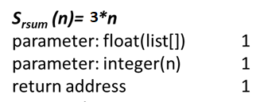
Examples of Evaluating Space Complexity
float abc(float a, float b, float c)
{
return a+b+b*c+(a+b-c)/(a+b)+4.00;
}
float rsum(float list[], int n)
{
if (n) return rsum(list, n-1)+ list[n-1];
return 0;
}
float sum(float list[], int n)
{
float fTmpSum= 0;
int i;
for (i= 0; i< n; i++)
fTmpSum+= list[i];
return fTmpSum;
}
S_{sum(n)}= 0

Slide 30
Time Complexity
Definition
The time complexity, T(p), taken by a program P is the sum of the compile time and the run time
T(P)= compile time + run (or execution) time
= c + t_{p}(n)
*Compile time does not depend on the instance characteristics
How to evaluate?
Use the system clock (machine dependent)
Number of steps performed (machine-independent)
Definition of a program step
A program step is a syntactically or semantically meaningful instruction whose execution time is independent of the instance characteristics.

Slide 31
Examples of Determining Steps
the first method: count increment by a step
EX: Algorithm for calculating sum of numbers in an array
float sum(float list[], int n)
{
float tempsum= 0;
count++; /* assignment of zero */
int i;
for i= 0 to n
{
count++; /* for the for loop */
tempsum+= list[i];
count++; /* for assignment */
}
count++; /* last execution of for */
count++; /* for return */
return tempsum;
}
2n+ 3

Slide 32
Examples of Determining Steps(Cont.)
void add(int a[][], int b[][], int c[][], int R, int C)
{
int i, j;
for i=0 to R
{
count++; /* for the for i loop */
for j=0 to C
{
count++; /* for the for j loop */
count++; /* for the addition */
c[i,j]= a[i,j] + b[i,j];
}
count++; /* last execution of for j */
}
count++; /* last execution of for i */
}
= (R* x)+1
= (R*(2+y))+1
= (R*(2+(2*C)))+1
= (2*R*C+2*R)+1
x
y

Slide 33
Examples of Determining Steps(Cont.)
float rsum(float list[], int n)
{
count ++; /* for if condition */
if (n!=1)
{
count++; /* for return and rsum invocation */
return rsum(list, n-1)+ list[n-1];
}
count++; /* return */
return list[0];
}
trsum(1) = 2
trsum(n) = 2 + trsum(n-1)
= 2 +(2 + trsum(n-2))
= 2*2 + trsum(n-2)
= 2*2+(2+ trsum(n-3))
= 2*3+ trsum(n-3)
= ……………
= 2*(n-1) + trsum(n-(n-1))
= 2*n-2+2
= 2*n

Slide 34
Examples of Determining Steps(Cont.)
The second method: build a table to count the number of steps
s/e: steps per execution
frequency: total numbers of times each statements is executed
Statement s/e Frequency Total Steps
float sum(float list[], int n) 0 0 0
{ 0 0 0
float sum=0; 1 1 1
int i; 0 0 0
for (i=0; i< n; i++) 1 n+1 n+1
sum= sum + list[i]; 1 n n
return sum; 1 1 1
} 0 0 0
Total 2*n +3

Slide 35
Examples of Determining Steps(Cont.)
The second method: build a table to count
s/e: steps per execution
frequency: total numbers of times each statements is executed
Statement s/e Frequency Total Steps
void add(int a[][], . . . 0 0 0
{ 0 0 0
int i, j; 0 0 0
for (i=0; i< R; i++) 1 R+ 1 R+ 1
for (j=0; j< C; j++) 1 R*(C+1) R*C+ R
c[i][j]= a[i][j] + b[i][j]; 1 R*C R*C
} 0 0 0
Total 2*R*C+2*R+1

Slide 36
Examples of Determining Steps(Cont.)
The second method: build a table to count
s/e: steps per execution
frequency: total numbers of times each statements is executed
Statement s/e Frequency Total Steps
float rsum(float list[], int n) 0 0 0
{ 0 0 0
if (n) 1 n+1 n+1
return rsum(list,n-1)+list[n-1] 1 n n
return list[0]; 1 1 1
} 0 0 0
Total 2*n + 2

Slide 37
Tasks on Performance Analysis
Write an algorithm for matrix multiplication and calculate the its time complexity.
Write an algorithm to print ‘n’ numbers in the Fibonacci series and estimate its time complexity.
Write an algorithm to find the largest element in an array and estimate the time complexity.
Write an algorithm to evaluate a polynomial using Horner’s rule and estimate the time complexity.
Write an algorithm to check whether the given number is Armstrong Number or not and estimate the time complexity.
Estimate the time complexity of factorial of a number using recursion.

Slide 38
Topics
Algorithm Specification
Pseudocode Convention
Types of Algorithms
Performance Analysis
Asymptotic Notations

Slide 39
Algorithm Analysis
To analyze the given algorithm, we need to know with which inputs the algorithm takes less time and with which inputs the algorithm takes a long time.
There are three types of analysis:
Worst case Analysis
Defines the input for which the algorithm takes a long time (slowest time to complete).
Best case Analysis
Defines the input for which the algorithm takes the least time (fastest time to complete).
Average case Analysis
Assumes that the input is random.
Run the algorithm many times, using many different inputs.
compute the total running time (by adding the individual times), and divide by the number of times the algorithm has excuted.

Slide 40
Asymptotic Notations
Asymptotic notations are the mathematical notations used to describe the running time of an algorithm when the input tends towards a particular value or a limiting value (say ‘n’).
The simplest example is a function ƒ (n) = n^2+3n,
the term 3n becomes insignificant compared to n^2 when n is very large.
The function "ƒ (n) is said to be asymptotically equivalent to n^2 as n → ∞", and here is written symbolically as ƒ (n) ~ n^2.

Slide 41
Asymptotic Notations
The commonly used asymptotic notations to represent the time complexity of an algorithm:
O (Big-Oh) Notation
Ω (Omega) Notation
θ (Theta) Notation
o (Little-oh) Notation
ⴍ (Little-omega) Notation
Notes:
Omega – best case , Big oh – worst case , Theta - average case

Slide 42
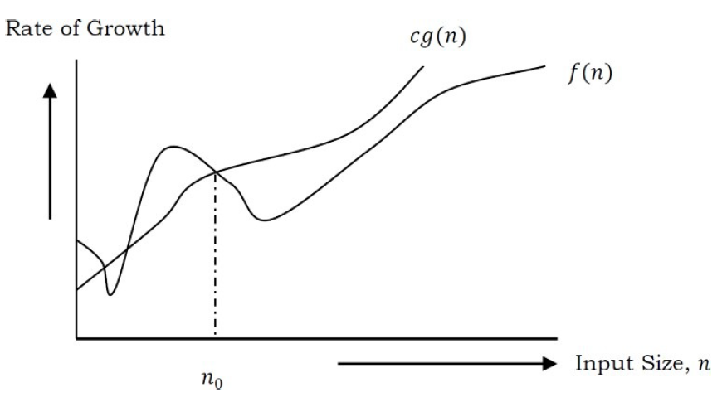
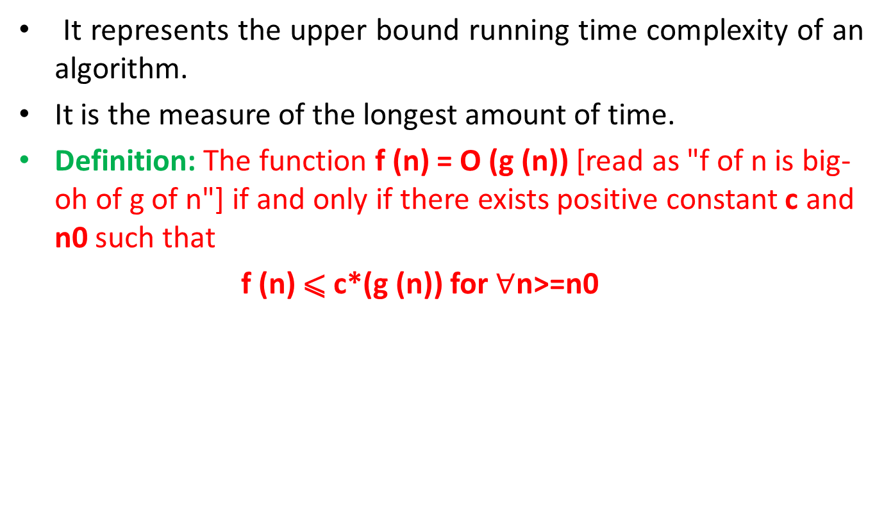
O (Big-Oh) Notation-Upper Bounding function
It represents the upper bound running time complexity of an algorithm.
It is the measure of the longest amount of time.
Definition: The function f (n) = O (g (n)) [read as "f of n is big-oh of g of n"] if and only if there exists positive constant c and n0 such that
f (n) ⩽ c*(g (n)) for $∀$n>=n0

Slide 43
Examples on O (Big-Oh) Notation
Example-1: Find upper bound for f(n) = 3n + 8
Example-2: Find upper bound for f(n) = n² + 1
Example-3: Find upper bound for f(n) = n⁴ + 100n² + 50
Example-4: Find upper bound for f(n) = 2n³ – 2n²
Example-5: Find upper bound for f(n) = n
Example-6: Find upper bound for f(n) = 410

Slide 44
Examples on O (Big-Oh) Notation
Example-1: Find upper bound for f(n) = 3n + 8
Solution: 3n + 8 ≤ 4n, for all n ≥ 8
∴ 3n + 8 = O(n) with c = 4 and n0 = 8
Example-2 Find upper bound for f(n) = n2 + 1
Solution: n2 + 1 ≤ 2n2, for all n ≥ 1
∴ n2 + 1 = O(n2) with c = 2 and n0 = 1
Example-3 Find upper bound for f(n) = n4 + 100n2 + 50
Solution: n4 + 100n2 + 50 ≤ 2n4, for all n ≥ 11
∴ n4 + 100n2 + 50 = O(n4 ) with c = 2 and n0 = 11
Example-4 Find upper bound for f(n) = 2n3 – 2n2
Solution: 2n3 – 2n2 ≤ 2n3, for all n > 1
∴ 2n3 – 2n2 = O(n3 ) with c = 2 and n0 = 1
Example-5 Find upper bound for f(n) = n
Solution: n ≤ n, for all n ≥ 1
∴ n = O(n) with c = 1 and n0 = 1
Example-6 Find upper bound for f(n) = 410
Solution: 410 ≤ 410, for all n > 1
∴ 410 = O(1) with c = 1 and n0 = 1

Slide 45
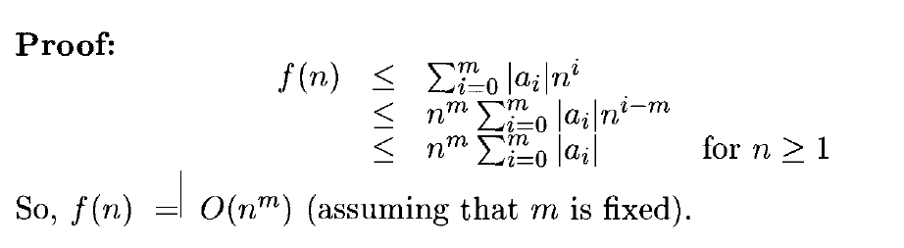
O (Big-Oh) Notation

Slide 46
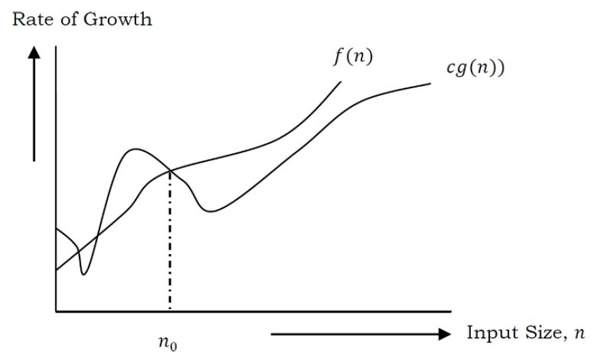
Ω (Omega) Notation-Lower Bounding function
The notation Ω(n) is the formal way to express the lower bound of an algorithm's running time.
Definition: The function f (n) = Ω (g (n)) [read as "f of n is omega of g of n"] if and only if there exists positive constant c and n₀ such that
F (n) ≥ c* g (n) for all n, n≥ n₀

Slide 47
Examples on Ω (Omega) Notation
Example-1: Find lower bound for f(n) = 5n².
Example-2: Find lower bound for f(n) = 10n²+ 4n + 2
Example-3: Find lower bound for f(n) = 6 * 2^{n} + n²
Example-4: Prove f(n) = 100n + 5 ≠ Ω(n²).
Example-5: Prove that 2n = Ω (n), n³ = Ω (n³), n³= O(logn).

Slide 48
Examples on Ω (Omega) Notation
Example-1 Find lower bound for f(n) = 5n2.
Solution: ∃ c, n0 Such that: 0 ≤ cn²≤ 5n² ⇒ cn² ≤ 5n² ⇒ c = 5 and n0 = 1
∴ 5n2 = Ω(n2) with c = 5 and n0 = 1
Example-2 Prove f(n) = 100n + 5 ≠ Ω(n2).
Solution: ∃ c, n0 Such that: 0 ≤ cn2 ≤ 100n + 5
100n + 5 ≤ 100n + 5n(∀n ≥ 1) = 105n
cn2 ≤ 105n ⇒ n(cn - 105) ≤ 0
Since n is positive ⇒cn - 105 ≤0 ⇒ n ≤105/c
⇒ Contradiction: n cannot be smaller than a constant
Example-3 2n = Ω (n), n³ = Ω (n³)

Slide 49
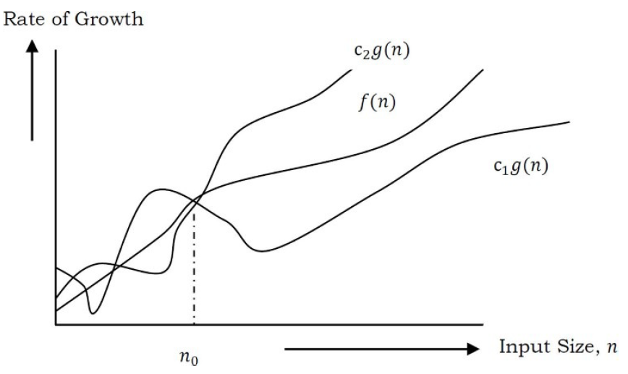
θ (Theta) Notation
The notation θ(n) is the formal way to express both the lower bound and the upper bound of an algorithm's running time.
Definition: The function f (n) = θ (g (n)) [read as "f is the theta of g of n"] if and only if there exists positive constant c₁, c₂ and n₀ such that
c₁*g (n) ≤ f(n)≤ c₂*g(n)for all n, n≥ n₀

Slide 50

Examples on θ (Theta) Notation
Prove that 3n+2 = $θ$(n)
Prove that 10n²+4n +2 = $θ$(n²)
Prove that n³ + 106n²= $θ$(n³)
Prove that the following is incorrect:
n²/log n= $θ$(n²)

Slide 51

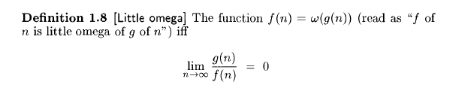
Little oh and Little omega Notation
Example: The function 3n +2 = o(n²)

Slide 52
Why is it called Asymptotic Analysis?
From the discussion above, we can easily understand that, in every case for a given function f(n) we are trying to find another function g(n) which approximates f(n) at higher values of n.
In mathematics we call such a curve an asymptotic curve. In other terms, g(n) is the asymptotic curve for f(n). For this reason, we call algorithm analysis asymptotic analysis.

Slide 53
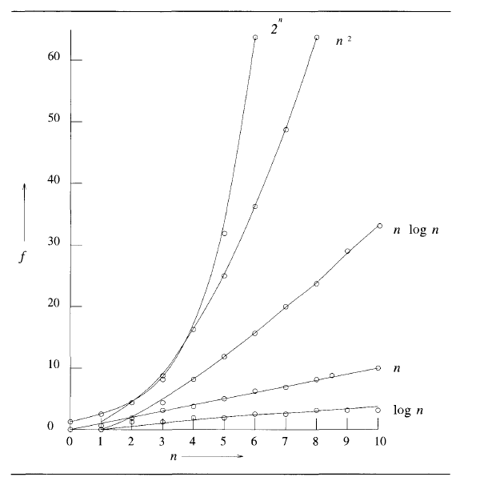
Different Asymptotic functions

Slide 54
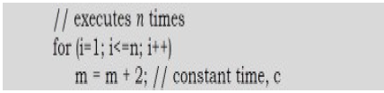
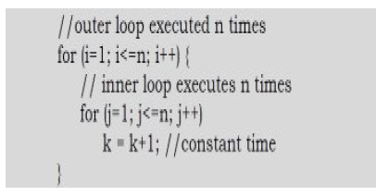
Guidelines for Asymptotic Analysis
1) Loops: The running time of a loop is, at most, the running time of the statements inside the loop (including tests) multiplied by the number of iterations.
2) Nested loops: Analyze from the inside out. Total running time is the product of the sizes of all the loops.

Slide 55
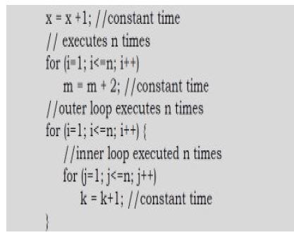
Guidelines for Asymptotic Analysis
3. Consecutive statements: Add the time complexities of each statement.

Slide 56
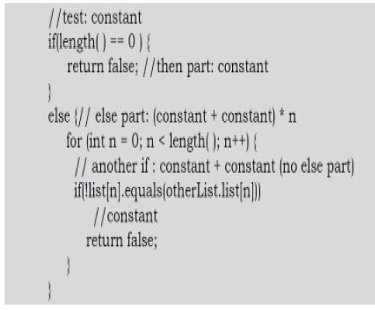
Guidelines for Asymptotic Analysis
4) If-then-else statements: Worst-case running time: the test, plus either the then part or the else part (whichever is the larger).

Slide 57


Guidelines for Asymptotic Analysis
5) Logarithmic complexity: An algorithm is O(logn) if it takes a constant time to cut the problem size by a fraction (usually by ½).

Slide 58
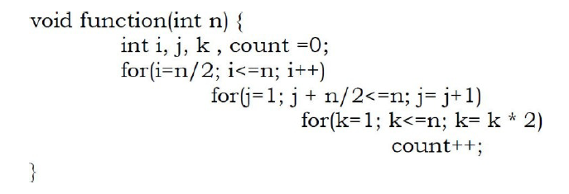
Tasks on Performance Analysis
Problem 1: What is the running time of the following function?

Slide 59
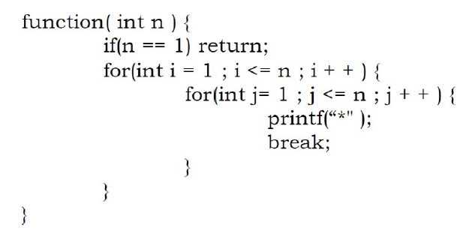
Tasks on Performance Analysis
Problem 2: Find the complexity of the program below.

Slide 60
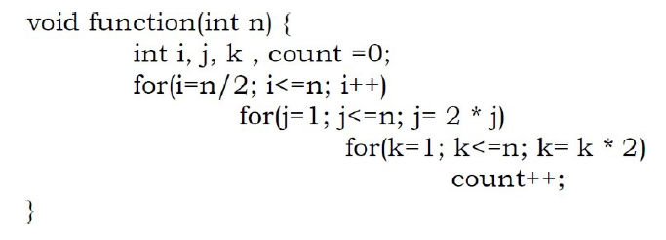
Tasks on Performance Analysis
Problem 3: Find the complexity of the program below.

Slide 61
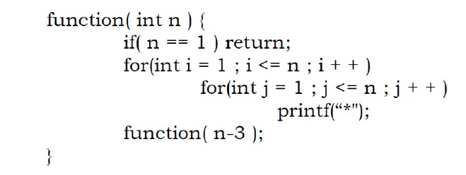
Tasks on Performance Analysis
Problem 4: Write a recursive function for the running time T(n) of the function given below.

Slide 62


